Slide 1
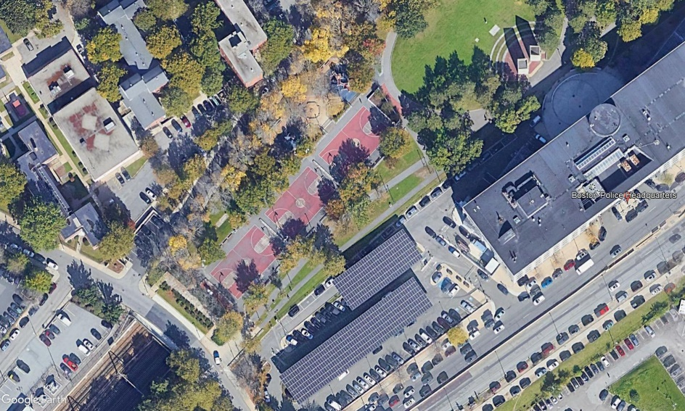
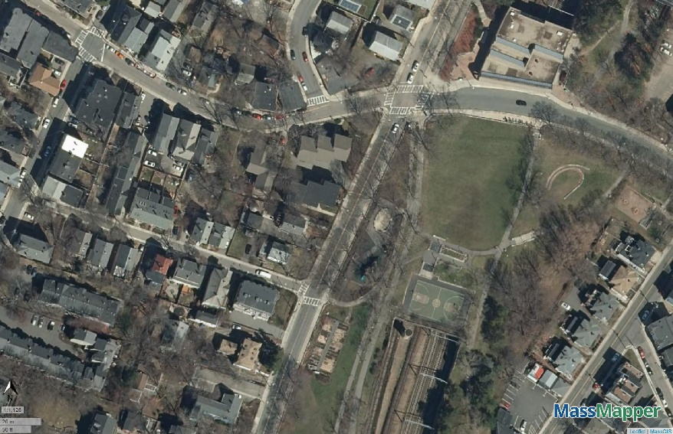
Southwest Corridor State Park
Spray Deck Rehabilitation
Mission Hill Recreation Area
Stony Brook Recreation Area
Boston, MA
DCR Project Presentation
October 2022

Slide 2

Commonwealth of Massachusetts
Governor
Charles D. Baker
Lieutenant Governor
Karyn E. Polito
Energy and Environmental Secretary
Bethany A. Card
Department of Conservation and Recreation Commissioner
Douglas J. Rice

Slide 3

DCR Mission Statement
To protect, promote and enhance our
common wealth of natural, cultural
and recreational resources
for the well-being of all.

Slide 4
Purpose of Presentation
Provide an opportunity to review proposed site improvements:
Present the scope and schedule for the rehabilitation of the Mission Hill & Stony Brook Spray Decks & Playgrounds
Review next steps

Slide 5
Project Team
Department of Conservation and Recreation
Owner
Coneco Engineers & Scientists, Inc.
Site Engineers

Slide 6

Mission Hill Recreation Area
Improvements to the Spray Deck, Playground & Accessibility

Slide 7
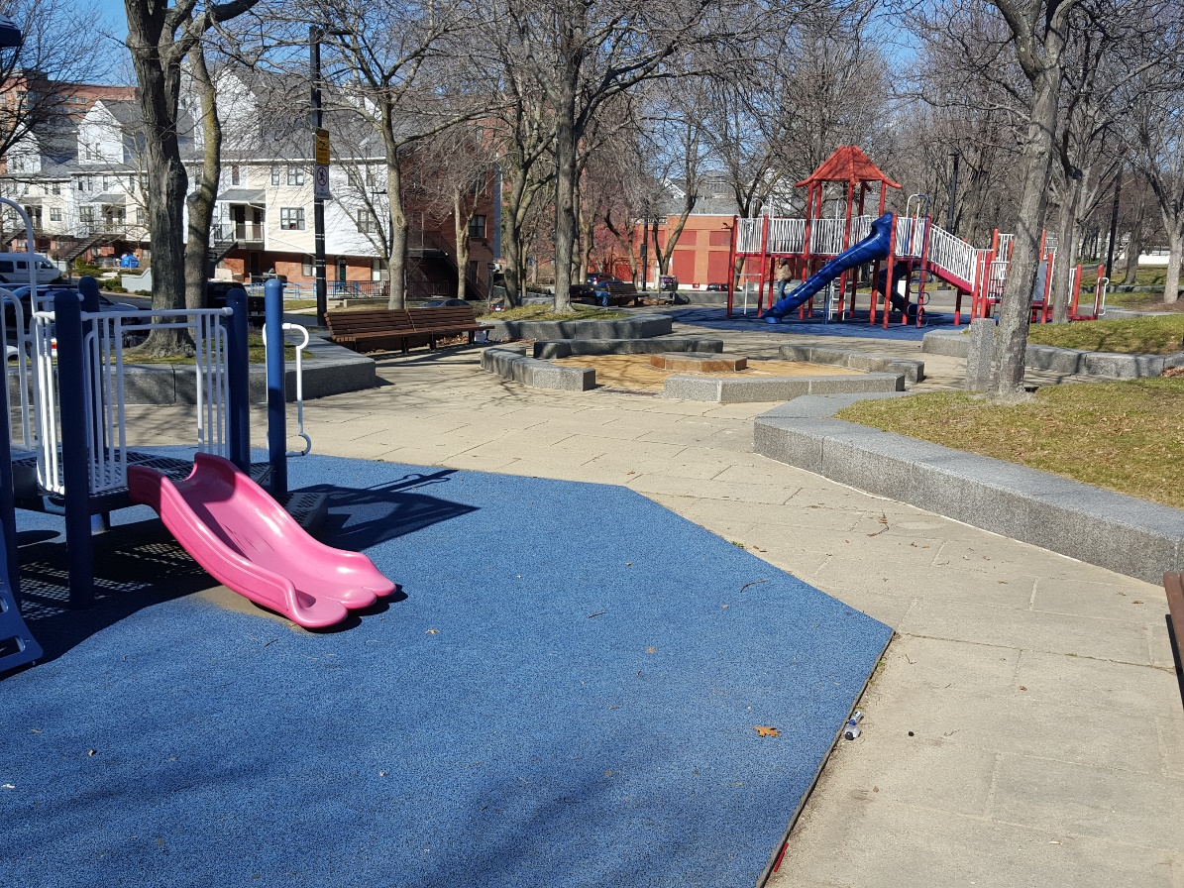
Purpose of Project:
Modernize the playground features
Provide new soft safety surfacing throughout the spray deck and playgrounds
Improve walkways to meet ADA requirements
New benches
Mission Hill Spray Deck & Playground Rehabilitation
Project Purpose

Slide 8
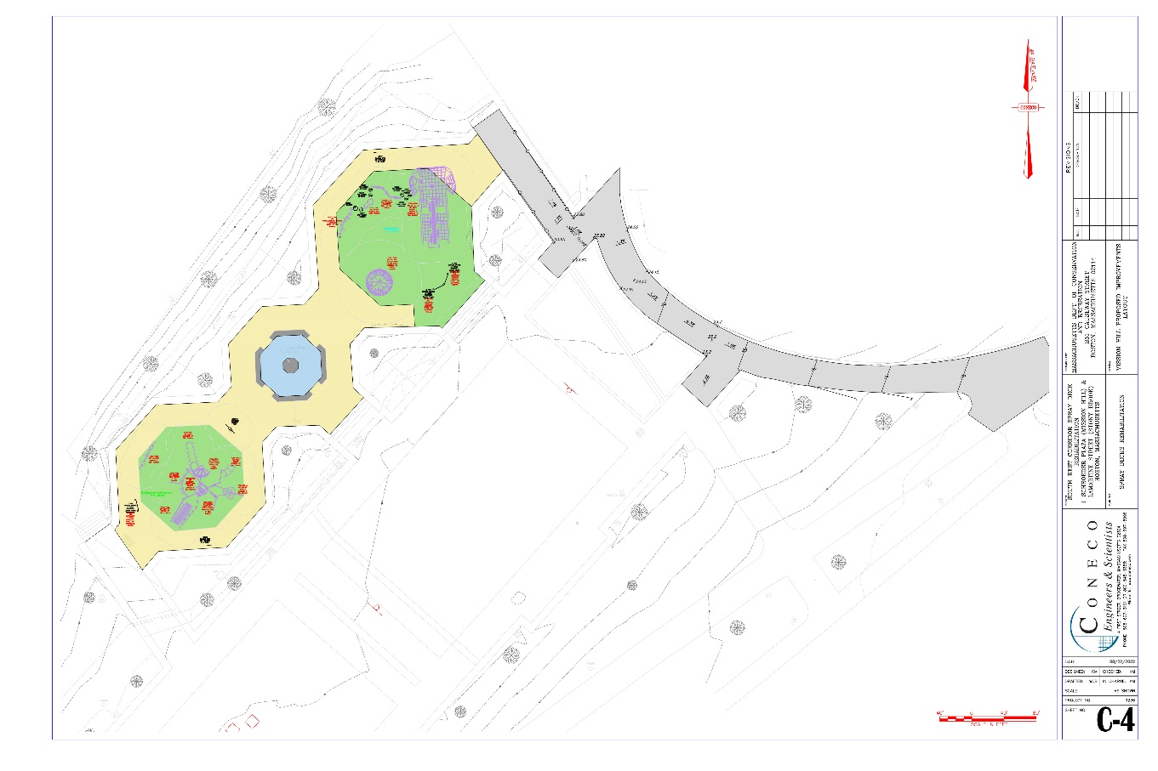
Selected Alternative:
New soft surfacing within the spray deck and playgrounds
New playground equipment
Improved access from the Southwest Corridor Trail
Minimized impacts to the MBTA tunnel
Mission Hill Spray Deck & Playground Rehabilitation
Selected Alternative

Slide 9
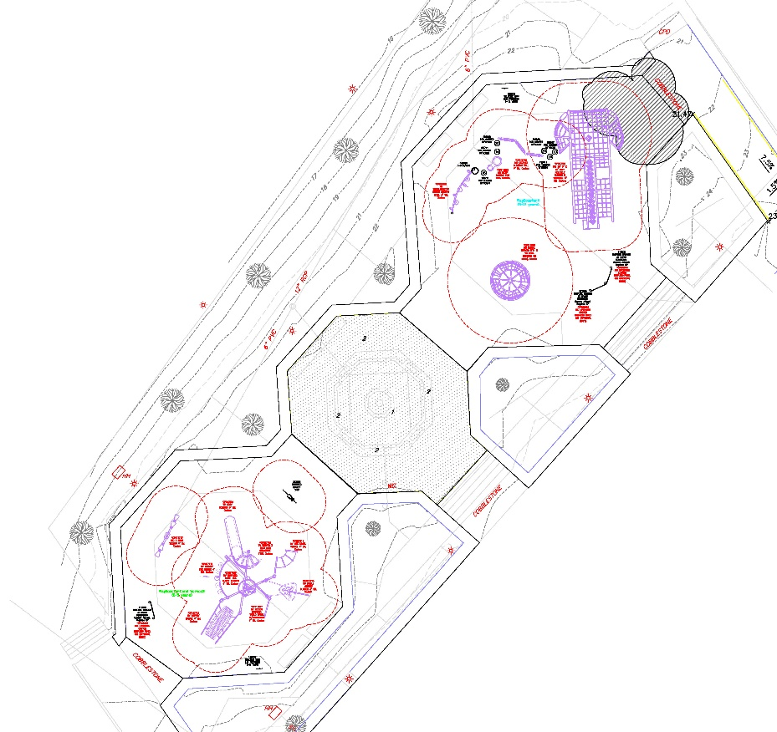
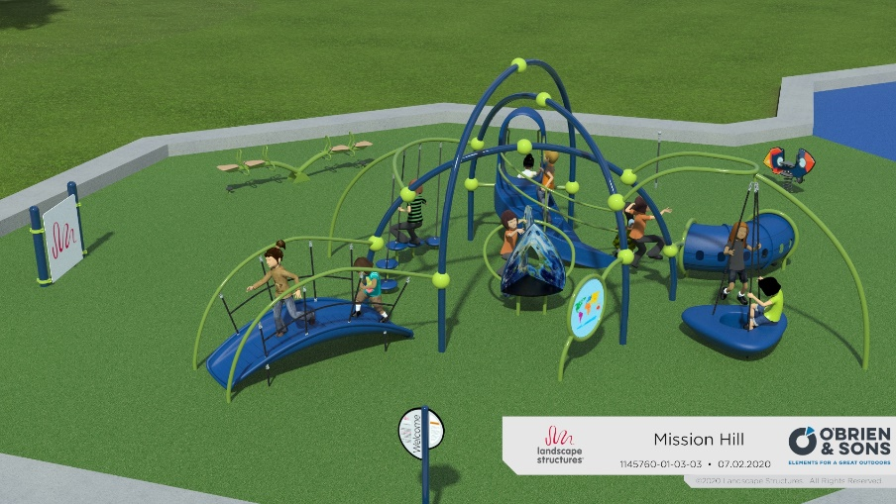
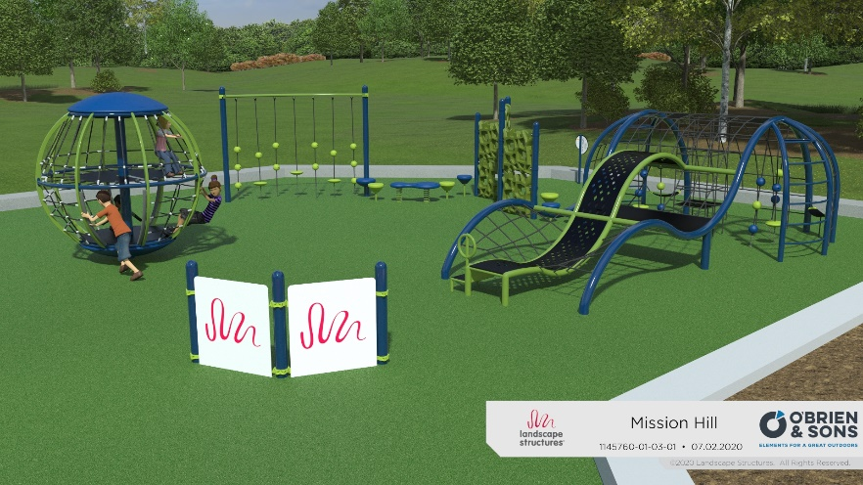
Playground Improvements
  New modern features
  Areas geared toward age groups
  Cushioned soft surfacing
Younger Children Themed (2-5 years)
Older Children Themed (5-12 years)
Mission Hill Spray Deck & Playground Rehabilitation
Selected Alternative

Slide 10
Benefits:
Upgraded facility will meet current DCR recreational standards
Improved safety
New/modern play features
Improved accessibility
Mission Hill Spray Deck & Playground Rehabilitation
Benefits

Slide 11

Stony Brook Recreation Area
Improvements to Spray Deck, Playground Surfacing & Accessibility

Slide 12
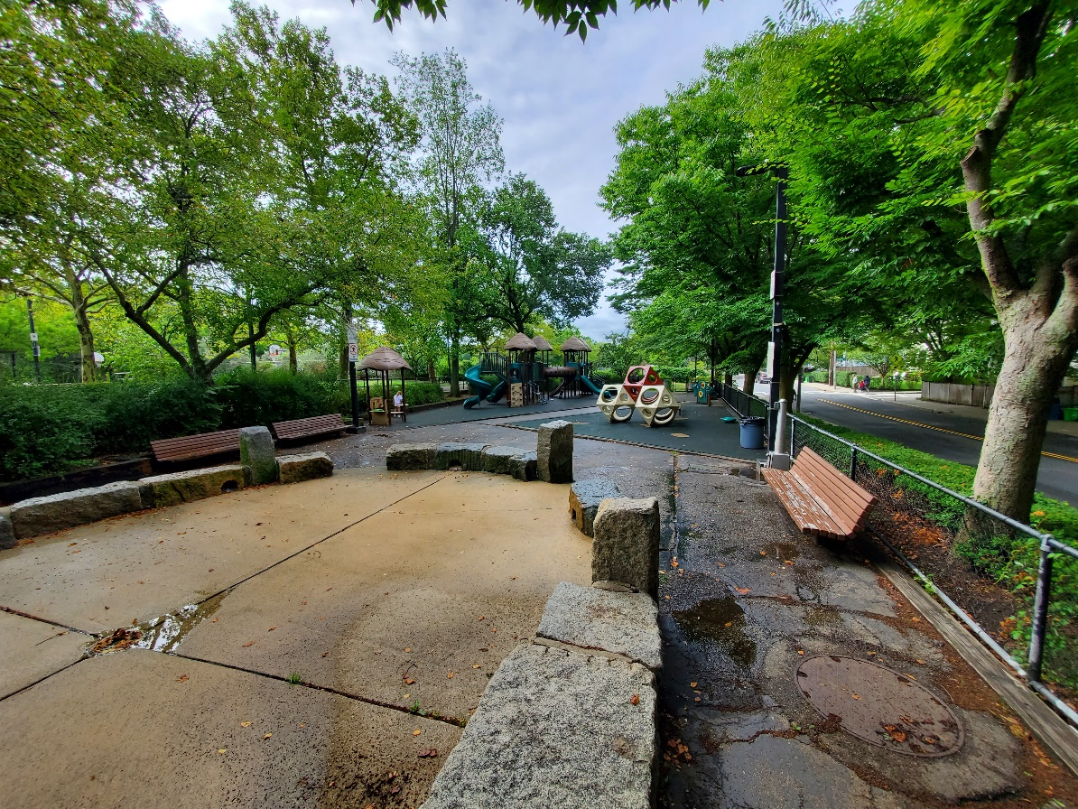
Purpose of Project:
Provide new soft safety surfacing within the spray deck & playgrounds
Smooth & resurface the asphalt surfaces around the spray deck & the walkway between the playgrounds
Add an ADA compliant walkway
New benches
Stony Brook Spray Deck and Playground Rehabilitation
Project Purpose

Slide 13
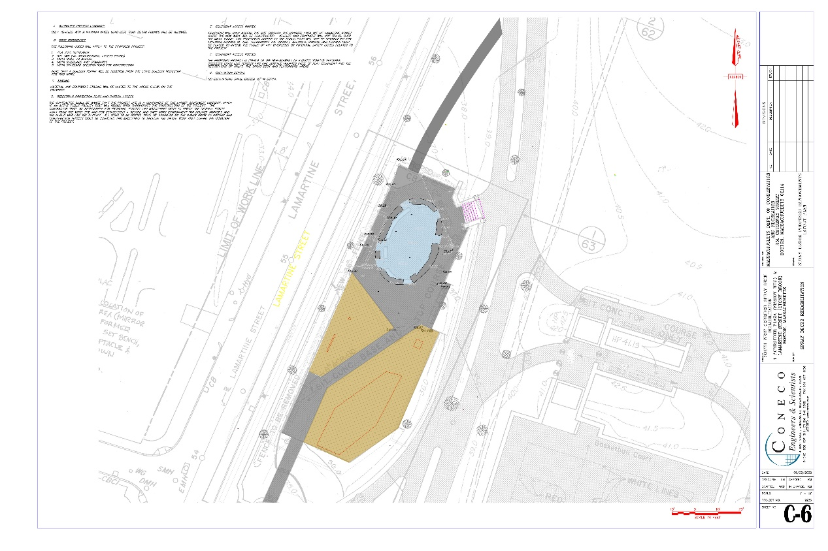
Selected Alternative:
New soft safety surface in spray deck and playgrounds
Improved access walkway
Minimized impacts to the MBTA tunnel
Stony Brook Spray Deck and Playground Rehabilitation
Selected Alternative

Slide 14
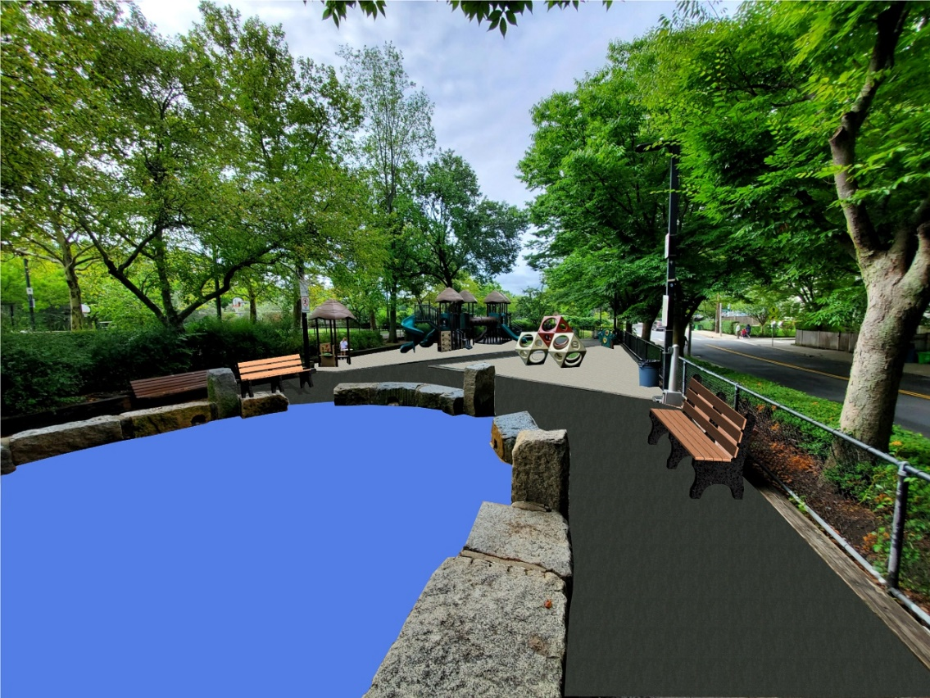
Playground Improvements
  Cushioned soft surfacing in the spray deck and playgrounds
  Improved smooth and accessible paved surfaces
  New Accessible walk from Southwest Corridor Trail
Stony Brook Spray Deck and Playground Rehabilitation
Selected Alternative

Slide 15
Benefits:
Upgraded facility will meet current DCR recreational standards
Improved safety
New/modern play features
Improved accessibility
Stony Brook Spray Deck and Playground Rehabilitation
Benefits

Slide 16
Total Project Cost: $1,200,000
Next Steps:
Review Comments
Schedule moving forward
  Construction: Winter 2022 through Spring 2023
  90 day Playground Closure for Construction: March 15th – June 15th
  All work completed and spray decks open by July 1st
Mission Hill & Stony Brook Spray Deck & Playground Rehabilitation
Anticipated Schedule

Slide 17
Questions/Discussion
Mission Hill Spray Deck & Playground Rehabilitation
Closing

Slide 18
Additional Information
For more information:
https://www.mass.gov/doc/ADD​
If you have questions or concerns or wish to subscribe to a DCR general information or project-related listserv: contact DCR’s Office of Community Relations at 617-626-4973 or Mass.Parks@state.ma.us.

